Slide 1
Integrating jQuery into a SharePoint 2010 Site
writing less, doing more
Notes:
This lecture introduces the fundamental concepts and programming syntax required to get up and running with jQuery . You will learn how to call the jQuery function with various types of selectors to retrieve wrapped sets of HTML elements so you can manipulate their properties such as their contents, position and their CSS styles. The lecture discusses how to register client-side event handlers the jQuery way focusing techniques that result in less code. The lecture also includes coverage of advanced jQuery topics such as executing AJAX calls across the network and leveraging the jQuery UI library to build custom jQuery themes and to leverage advanced jQuery UI controls such as the Accordion component and the Tabs component.

Slide 2
Agenda
jQuery Fundamentals
jQuery Programming
jQuery UI

Slide 3

jQuery Fundamentals
jQuery deigned to hide browser differences
Eliminates need to write browser-specific code
your code can target wide variety of browsers
jQuery focuses on 2 main things
Retrieving sets of elements from HTML pages
Performing operations on these sets of elements

Slide 4
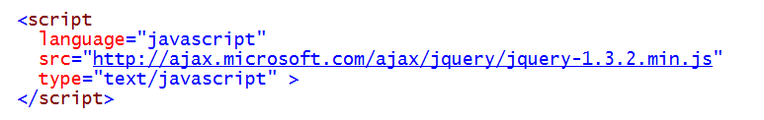
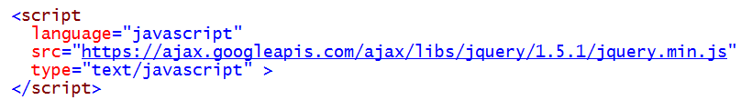
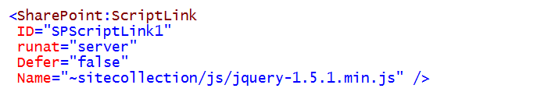
Linking to the jQuery Library
Use jQuery source from a CDN
Add jQuery source to SharePoint environment
Can be added to _layouts or in site collection (content DB)

Slide 5
DEMO
Deploying and Linking to the jQuery Library

Slide 6
Agenda
jQuery Fundamentals
jQuery Programming
jQuery UI

Slide 7
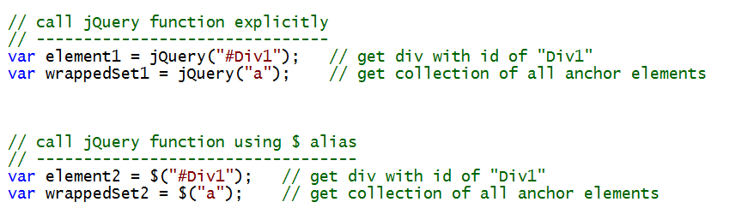
jQuery Function
jQuery library defines jQuery as a global function
Execution of jQuery function returns a jQuery object
$ symbol can be used as alias for jQuery function

Slide 8
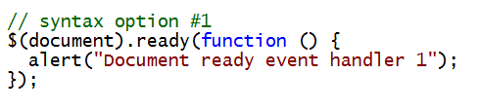
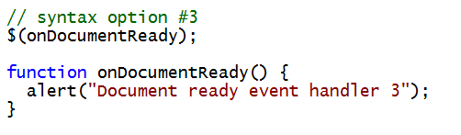
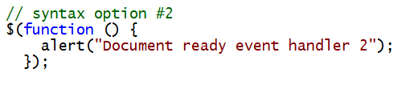
The Document Ready Event Handler
jQuery provides document ready event handler
Executed when DOM document is ready for access
Several different styles of syntax supported
Avoids problems associated with window.onload
Does not wait on all images and resources to download
Designed to supports registering multiple handlers

Slide 9
DEMO
Adding a Document Ready Event Handler

Slide 10
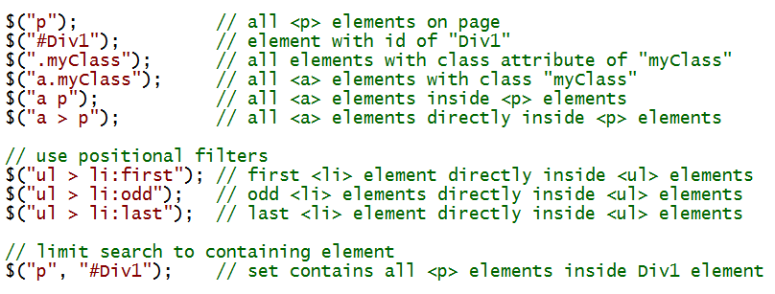
jQuery Selectors
Element retrieval based on Selectors
jQuery leverages familiar CSS selector syntax
Supports CSS3 selectors even in non-CSS3 browsers
jQuery function takes second parameter for container

Slide 11
jQuery Objects
jQuery object…
Is returned from call to jQuery function
Represents collection of zero or more elements
Is often referred to as a "wrapped set"
Has methods that operate on all elements in set
Encapsulates enumerating through elements in set

Slide 12

Updating Element Contents
Made possible through consistent methods
html() method
text() method

Slide 13
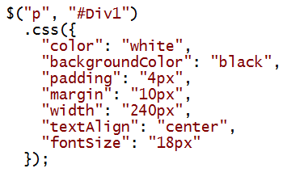
Assigning CSS Styles Dynamically
Adding style rules by name
Applying a CSS class

Slide 14
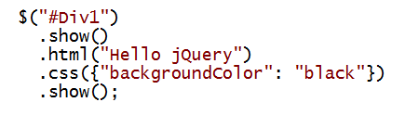
jQuery Library uses Cascading Methods
Methods return same collection passed as input
Allows a style to call multiple methods in chain
Vertical, more-readible syntax as support

Slide 15
DEMO
Programming with jQuery Objects

Slide 16
Agenda
jQuery Fundamentals
jQuery Programming
jQuery UI

Slide 17
jQuery UI Widgets
Buttons and buttonsets
Sliders
Progress bars
Auto completers
Date Pickers
Tabs
Accordion
Dialog Box

Slide 18
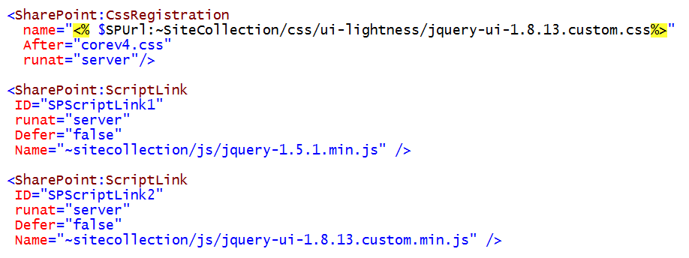
Linking to jQuery UI
Requires linking to extra files
The jQuery UI library
A CSS file for one of the jQuery UI themes

Slide 19
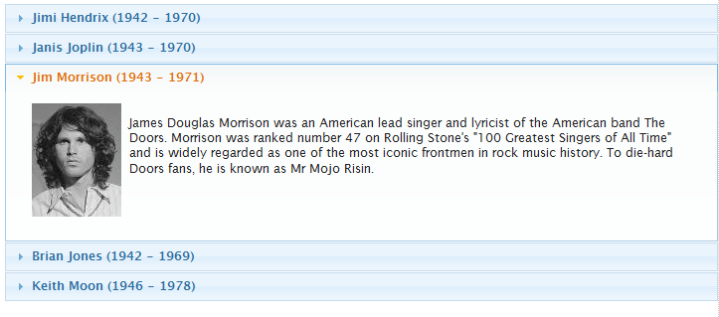
jQuery UI Accordion

Slide 20
DEMO
Programming with the jQuery UI Library

Slide 21
Agenda
jQuery Fundamentals
jQuery Programming
jQuery UI

